Slide 1


8 Puzzle: A Deep Dive into Search Algorithms
Welcome! This presentation explores the 8-puzzle problem, a classic AI challenge, and how it can be solved using various search algorithms.
Presented to : Dr Rasha Saleh
Team Members:
Youssef Mohamed Abd Elhady 192100121
Ahmed Ashraf Helmy 192100128

Slide 2

Introduction to the 8 Puzzle Problem
Objective
State Space
Arrange the numbered tiles in sequential order from 1 to 8, leaving the blank tile in the bottom right corner.
The set of all possible configurations of the 8 puzzle, which is incredibly large due to the many tile arrangements.
Actions
Moving the blank tile up, down, left, or right, depending on its position within the puzzle.

Slide 3
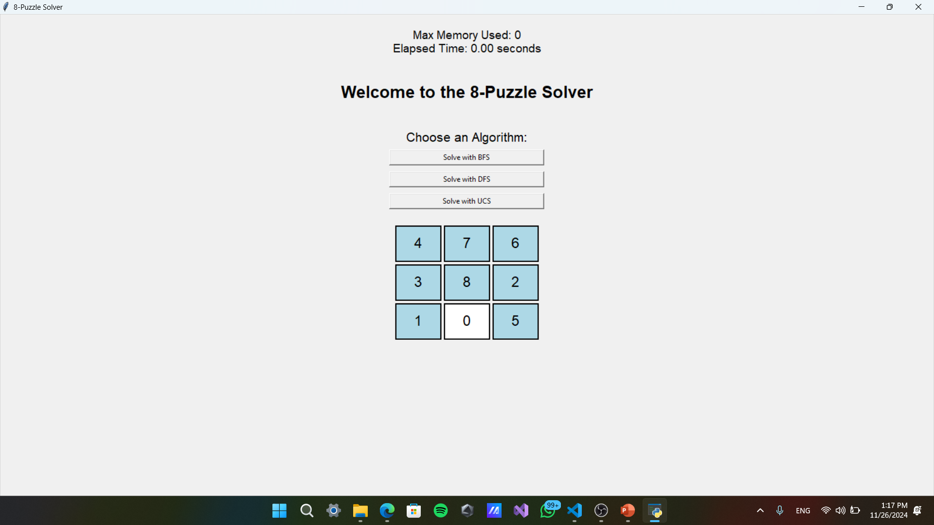
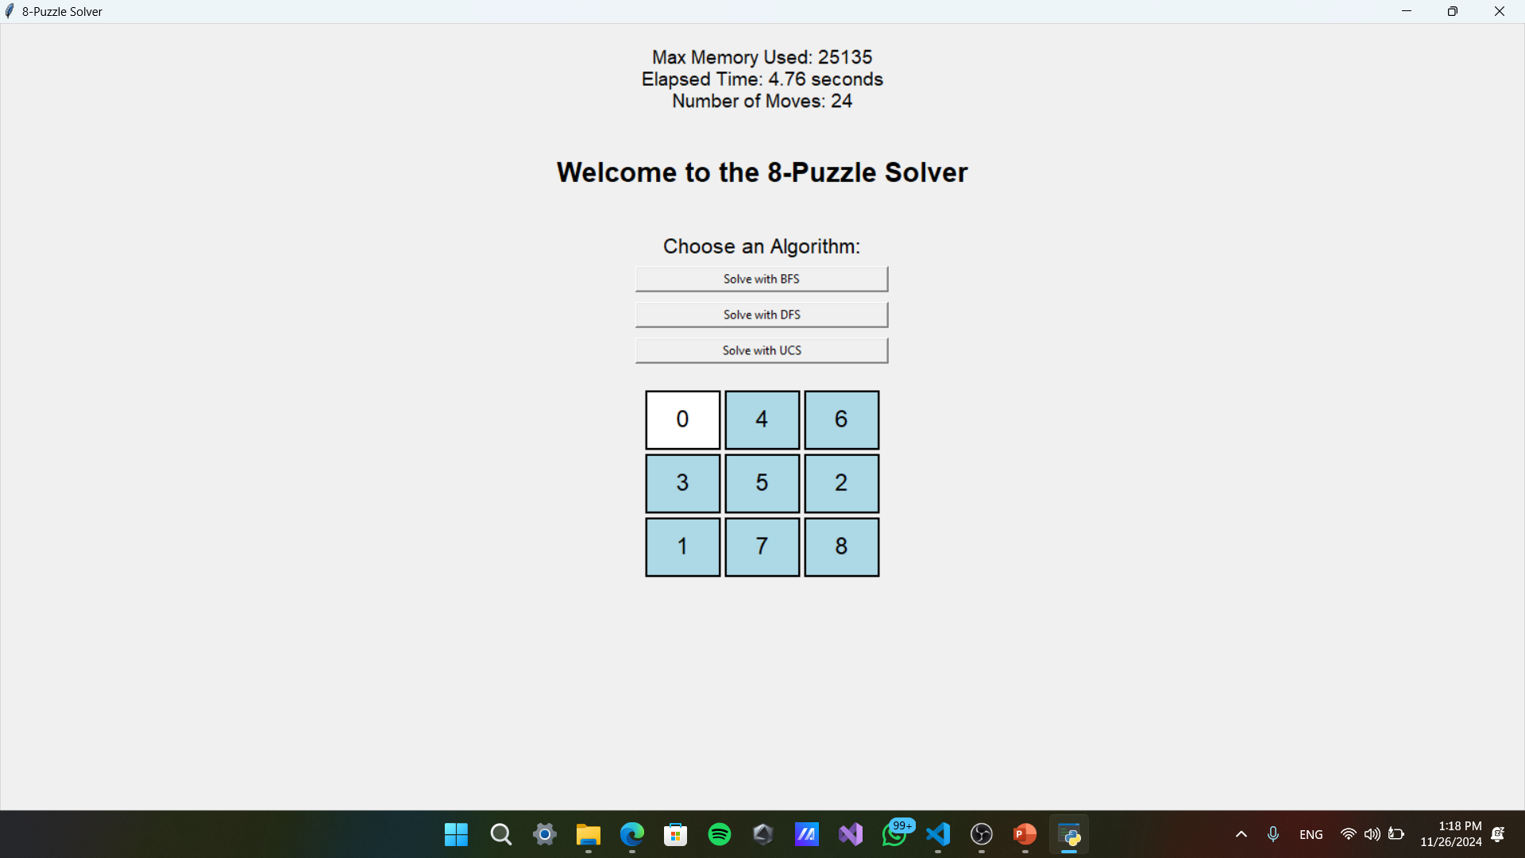
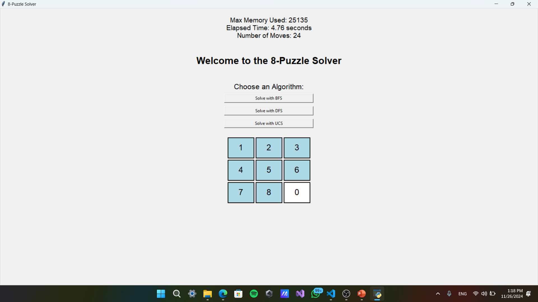
User Interface for the 8 Puzzle Home Page
Initial State
Intermediate State
Goal State
The starting configuration of the 8 puzzle with numbers and blank tile in random positions.
The state of the 8 puzzle after several moves, with tiles potentially in partially solved positions.
The desired final configuration where all tiles are in numerical order, with the blank tile in the bottom right corner.

Slide 4
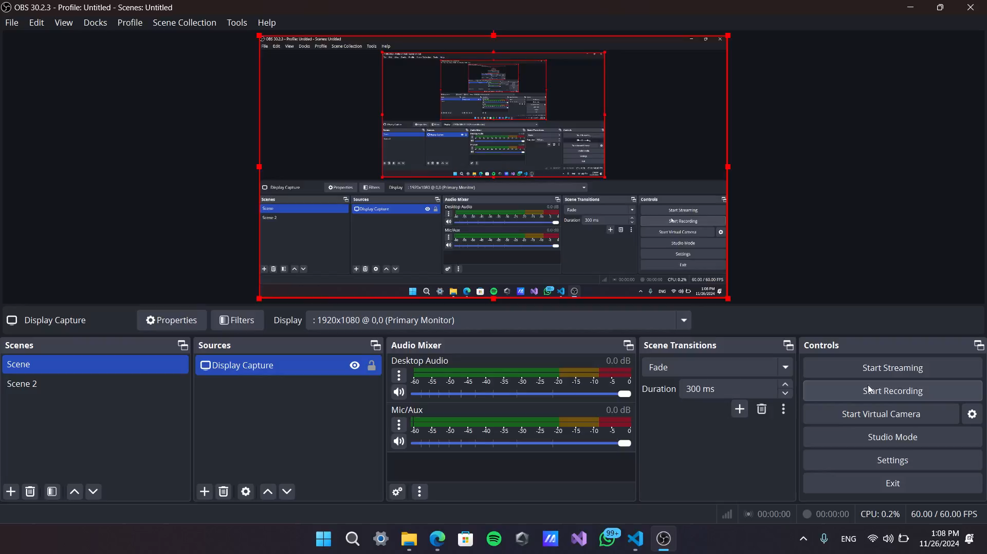
Visualization of the 8 Puzzle Game

Slide 5
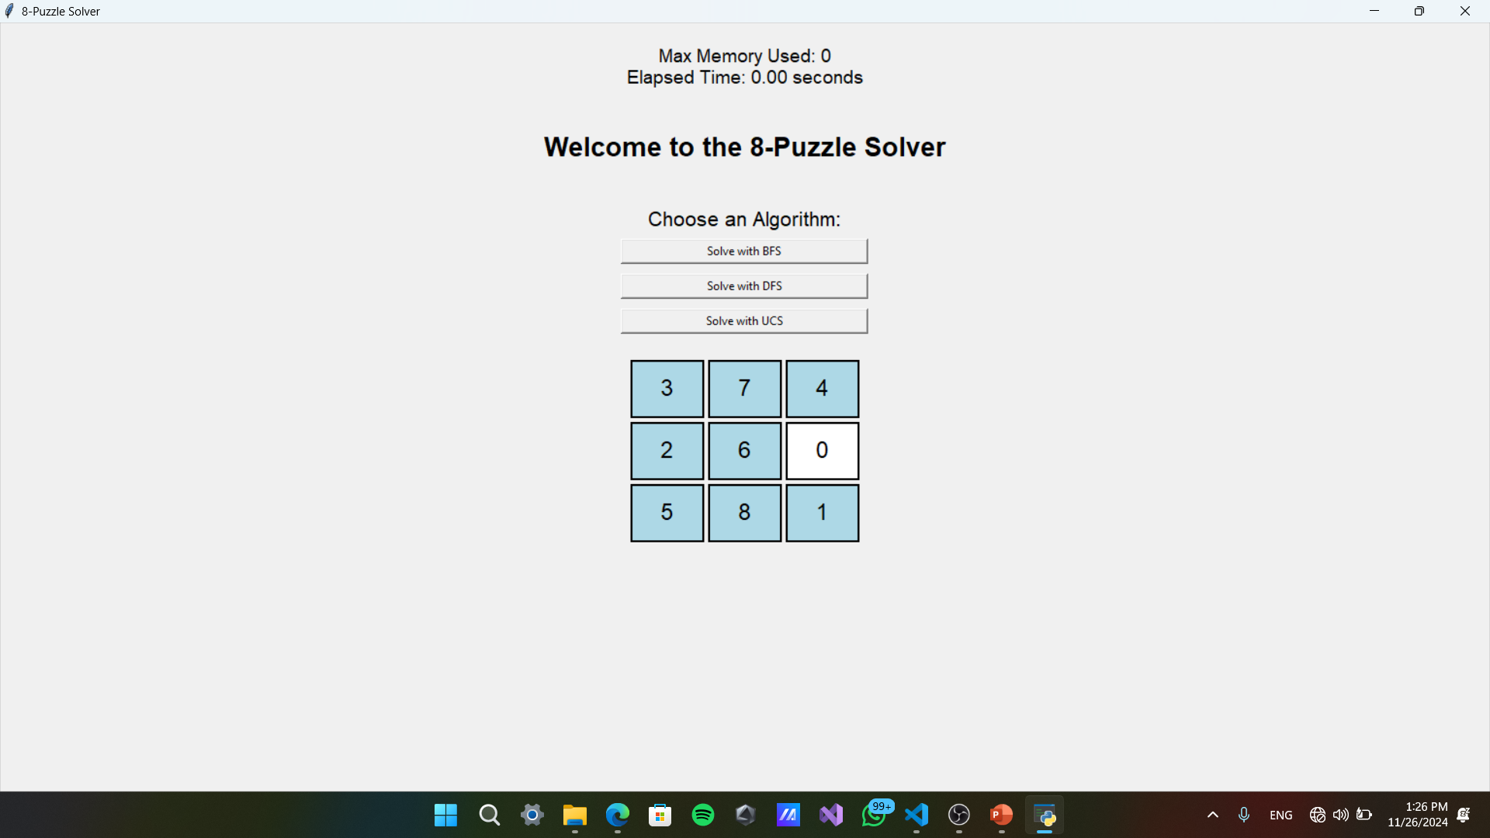


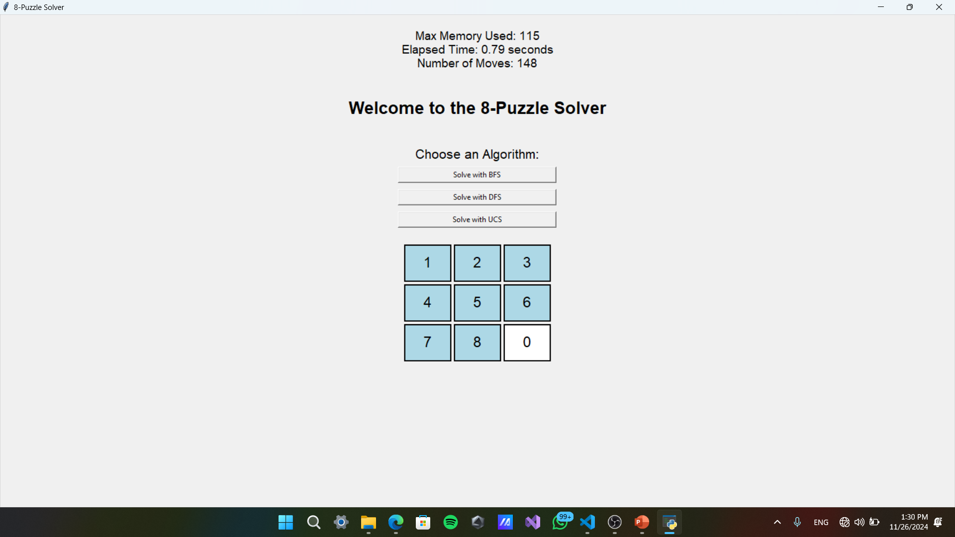

Depth-First Search (DFS) Algorithm
Exploration
DFS explores a single branch of the search tree to its maximum depth before backtracking.
Stack
Uses a stack data structure to keep track of visited nodes and the path taken.
Backtracking
If a dead end is reached, DFS backtracks to the previous node and explores another branch.

Slide 6


Uniform Cost Search (UCS) Algorithm
1
Cost-Based
UCS prioritizes the exploration of nodes with the lowest path cost, ensuring the optimal solution is found.
2
Priority Queue
UCS uses a priority queue to store nodes, where nodes with lower path costs are prioritized for expansion.
3
Optimal Solution
UCS guarantees finding the shortest path to the goal state, if one exists, by always choosing the path with the lowest cumulative cost.

Slide 7



Breadth-First Search (BFS) Algorithm
Level-by-Level
BFS explores nodes in a level-by-level fashion, expanding all nodes at a given depth before moving to the next level.
Queue
Uses a queue data structure to store nodes, ensuring nodes at the same level are explored in order.
Shortest Path
BFS guarantees finding the shortest path to the goal state, if one exists, by exploring nodes in a breadth-first manner.

Slide 8
Algorithm Comparison
Breadth-First Search (BFS)
Uninformed, Level-by-Level
Guaranteed shortest path; complete
High space complexity; can be slow for deep trees
O(bd)
O(bd)
Depth-First Search (DFS)
Uninformed, Depth-First
Low space complexity; fast for shallow trees
Doesn't guarantee shortest path; may get stuck in infinite branches
O(bm)
O(bm)
Uniform Cost Search (UCS)
Informed, Cost-Based
Guaranteed shortest path; optimal solution
Can be slow for large state spaces; high space complexity
O(bd)
O(bd)

Slide 9
Conclusion and Key Terms
Depth-First Search (DFS)
Uniform Cost Search (UCS)
Breadth-First Search (BFS)
Explores a single branch to its maximum depth before backtracking.
Prioritizes nodes with the lowest path cost; guarantees the optimal solution.
Explores nodes level-by-level; guarantees the shortest path.
This presentation explored three core search algorithms – DFS, UCS, and BFS – highlighting their unique approaches to solving the 8-puzzle and their respective strengths and weaknesses in terms of efficiency and optimality. The choice of algorithm often depends on the specific needs of the problem and the balance between finding an optimal solution and computational resource constraints.

Slide 10
Links:
Drive For Video:
https://drive.google.com/drive/folders/19MsyK51GrOMw9EfdFV4neFvUzMAPRzSE?usp=drive_link
GitHub:
https://github.com/Y0usefMohamed/8-Puzzle-AI-Game

